Slide 1


Engagement Insights:
Top 5 Content Categories on Social Buzz

Slide 2


Today's agenda
Project recap
Problem
The Analytics team
Process
Insights
Summary

Slide 3

Social Buzz, a rapidly growing platform with over 500 million active users, focuses on anonymous user reactions to content. They face challenges managing vast unstructured data as they scale and prepare for an IPO. The firm was engaged to audit their big data practices, offer IPO guidance, and analyze content categories.
Project Recap

Slide 4


Problem
Over 100000 posts per day
36,500,000 pieces of content per year!
But how to capitalize on it when there is so much?
Analysis to find Social Buzz's top 5 most popular categories of content

Slide 5



ANDREW FLEMING
Chief Technology Architect
The Analytics team
MARCUS ROMPTON
Senior Principal
ABDULMALIK O. A.
Data Analyst

Slide 6
Process
1
Requirements gathering
2
Data Cleaning
3
Data Modelling
4
Data Visualization
5
Uncover Insights

Slide 7

Insights
16
49442
JANUARY
UNIQUE CATEGORIES
REACTIONS TO “STUDYING” POSTS
MONTH WITH MOST POSTS

Slide 8
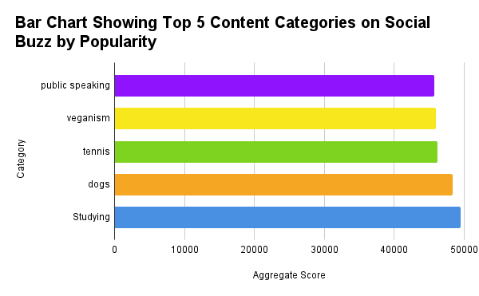

Slide 9
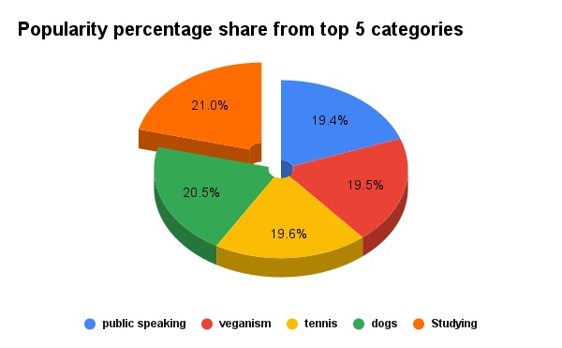

Slide 10

Analysis: The review of Social Buzz's content categories indicates that "Studying" leads in popularity with a score of 49,442, followed by "Dogs" with 48,398. Categories such as "Tennis," "Veganism," and "Public Speaking" also perform well, with scores ranging from 45,751 to 46,185.
Insight: The data reveals that educational content (Studying) and pet-related topics (Dogs) significantly drive user engagement. Additionally, lifestyle and hobby topics maintain a strong and consistent appeal among the audience.
Next Step: Social Buzz should focus on refining their content strategies to emphasize educational and pet-related topics, as these are major engagement drivers. Maintaining a robust presence in lifestyle and hobby categories will also help sustain audience interest and participation.
Summary

Slide 11

Thank you!
ANY QUESTIONS?

